Slide 1
Induction to Data Foundation in Data Visualization
Module 2
216H03L602
Jan- May 2026

Slide 2
Importance of Data Visualization
Visuals are processed faster than text
Reveals patterns, trends, and outliers
Supports data-driven decision making
Enhances communication of insights

Slide 3
Data Foundation
The groundwork for effective visualization
Ensures data is accurate, clean, and structured
Involves collection, storage, and preparation

Slide 4
Types of Data
Structured: Tables, databases (e.g., SQL)
Unstructured: Text, images, videos
Semi-structured: JSON, XML
Each type requires different handling

Slide 5
Data Quality Dimensions
Accuracy:
Correct and reliable data
Completeness:
No missing values
Consistency:
Uniform format and values
Timeliness:
Up-to-date information
Reliability:
Trusted data sources

Slide 6
Data Preparation Steps
Data collection from various sources
Cleaning: Remove duplicates, handle missing values
Transformation: Normalize, aggregate, encode
Integration: Combine datasets for analysis

Slide 7
Importance of Metadata
Metadata = 'data about data'
Describes source, format, and meaning
The source of information matters
The reason or situation in which data collected
Helps in interpreting and managing data
Essential for data governance

Slide 8
Choosing the Right Data
Primary V/S Secondary
Align data with business goals:
(Objectives of Presentation or reason for collecting)
Ensure relevance to the audience:
Create visuals those will have long lasting impact on the audience
Choose the appropriate methods, tools, presentation options
Balance detail vs. summary (granularity)
Too much information will reduce impact while too little may not convince the audience
Consider ethical and privacy aspects

Slide 9
Data Visualization Principles
Choose appropriate chart types
Keep visuals simple and clear
Highlight key insights
Avoid misleading representations

Slide 10
Addressing the Design of Visualisations
Strong data foundation = reliable insights
Visualization is storytelling with data
Practice with real-world datasets
Explore → Clean → Visualize → Interpret

Slide 11
Importance of Visualization Design
Enhances data comprehension and insight discovery
Recognition is easier than remembrance
Easy to interpret patterns with graphs and figures
Improves communication and storytelling
Less time to communicate more
Reduces misinterpretation and cognitive load
The audience is bound to the visualization

Slide 12
Steps in Visualization Design
Understanding the Audience
Choose the right Chart Type
Colour Theory
Typography, Text and Labels
Layouts and Composition

Slide 13
Steps in Visualization Design
Understanding the Audience
Tailor visuals to audience's knowledge level
Educational, Ethnical background
Consider stakeholders' goals and interests
Reason for presentation
Available time for interaction
Use appropriate complexity and terminology
Tool for presentation
Age, Gender, Nationality

Slide 14
Choosing the Right Chart Type
Bar/Column: Compare categories
Line: Show trends over time
Pie: Show proportions (use sparingly)
Scatter: Show relationships between variables

Slide 15
Color Theory in Visualization
Use colour to highlight, not decorate
Colours attract attention but may be distracting
Limit color palette for clarity
Too many colours and colours which are close to each other may lead to confusion
Use colorblind-friendly schemes
Avoid using red-green yellow-brown combination
Maintain contrast for readability

Slide 16
Typography and Labels
Use clear, legible fonts
Avoid excessive font styles or sizes
Label axes and data points clearly
Use annotations to explain insights
Use simple language and cues instead of complicated words

Slide 17
Layout and Composition
Gestalt Principles of Design
Similarity (grouping like items)
Proximity (grouping nearby items)
Closure (seeing incomplete shapes as complete)
Continuity (perceiving smooth paths)
Figure/Ground (separating objects from background)
Symmetry
Align elements for visual balance
Use whitespace to reduce clutter
Group related elements together
Maintain consistent margins and spacing

Slide 18
Accessibility in Visualization Design
Ensure readability for all users
Use alt text for charts in digital formats
Avoid relying solely on color to convey meaning
Test with accessibility tools

Slide 19
Common Pitfalls to Avoid in Visual Design
Overloading with data or visuals
Using misleading scales or axes
Ignoring context or audience needs
Neglecting interactivity or responsiveness

Slide 20
Human Perception and Information Processing
Perception
Sensory System
Stages of Perception
Attention span
Cognitive processing
Working Memory Limits
Visual perception principles
Information overload

Slide 21
Importance of Studying Perception
Explains how humans interpret sensory input
We see with brain and not eyes
Helps design effective communication and visuals
Supports better decision-making and learning
Presented in appropriate manner helps people to understand, grasp and decide
Comparison in columns instead of paragraphs
bullets and numbers instead of longer text

Slide 22
Sensory Systems Overview
Vision: Primary channel for information intake
Hearing: Understanding speech and sound cues
Touch, Smell, Taste: Complementary senses
Integration of multiple senses for perception

Slide 23
Stages of Perception
Sensation: Receiving stimuli
Attention: Selecting relevant information
Interpretation: Assigning meaning
Response: Acting on perceived information

Slide 24
Attention Mechanisms
Selective attention: Focusing on key stimuli
Instead of advertisement on the screen we focus on the cricket match
Divided attention: Handling multiple inputs
In games, driving we can focus on multiple inputs
Sustained attention: Maintaining focus over time
Created in better manner can create interest and increase attention span
Influencing factors: novelty, relevance, emotion

Slide 25
Cognitive Processing
Encoding: Transforming input into memory
Storage: Retaining information
Retrieval: Accessing stored knowledge
Influenced by prior experience and context

Slide 26
Working Memory and Limits
Capacity: 7 ± 2 items
Provide limited number of option at a time
Short duration without rehearsal
Unless bombarded people tend to forget
Critical for reasoning and comprehension
Design implication: avoid overload
Too much information will distract and dilute the communication message

Slide 27
Information Overload
Too much data reduces comprehension
Causes stress and poor decision-making
Strategies: simplify, prioritize, chunk information

Slide 28
2.3 Geospatial Displays
Connecting to Geographic Data
Assigning Geographic Roles
Creating Geographic
Hierarchies
Proportional Symbol Maps
Choropleth Maps

Slide 29
Geospatial Analysis
Geospatial analysis is the gathering, display, and manipulation of imagery, GPS, satellite photography and historical data, described explicitly in terms of geographic coordinates or implicitly, in terms of a street address, postal code, or forest stand identifier as they are applied to geographic models
Applications:
crisis management
climate change modeling
weather monitoring
sales analysis
human population forecasting
animal population management.

Slide 30
Geospatial displays
The Heat Map :
Visualise data through variations in colouring.
Useful for cross-examining multivariate data, through placing variables in the rows and columns and colouring the cells within the table.
Good for showing variance across multiple variables, revealing any patterns, displaying whether any variables are similar to each other, and for detecting if any correlations exist in-between them

Slide 31
Benefits of Heat Maps
Analytics tools like Google Analytics or SiteCatalyst are great at providing metrics to show which pages users visit, but they can lack detail when it comes to understanding how users engage with those pages. Heatmaps can give a more comprehensive overview of how users are really behaving.
A lot more visual than standard analytics reports, which can make them easier to analyze at a glance.
More accessible, particularly to people who are not accustomed to analyzing large amounts of data.

Slide 32
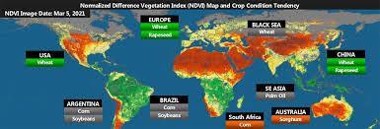
Geospatial displays
The Heat Map :
A heat map graph is a great way to compare categorical data using color
Similar to the tree map, a heat map represents the values by a variable in a hierarchy.
Typically used to represent weather reports

Slide 33
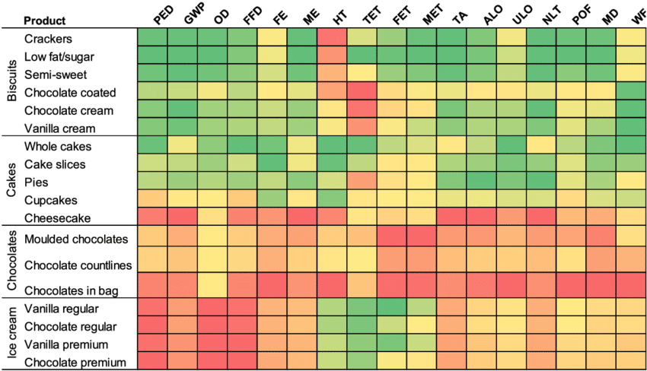
Geospatial displays
The Heat Map :
NOT restricted only for weather

Slide 34
Geospatial displays
The Heat Map :
For navigating heat map as a visualization tool include:
Can be used effectively when a large amount of data is available
It is important to have enough information to ensure that any anomalies do not affect the overall heatmap picture
Adding a size variation for squares to show the concentration of intersecting factors while adding a third element.
Using a shape other than a square to convey meaning in a more impactful way.
As with other forms of quantitative data, heatmaps can tell you what has happened on a page, but cannot tell you why that happened.

Slide 35
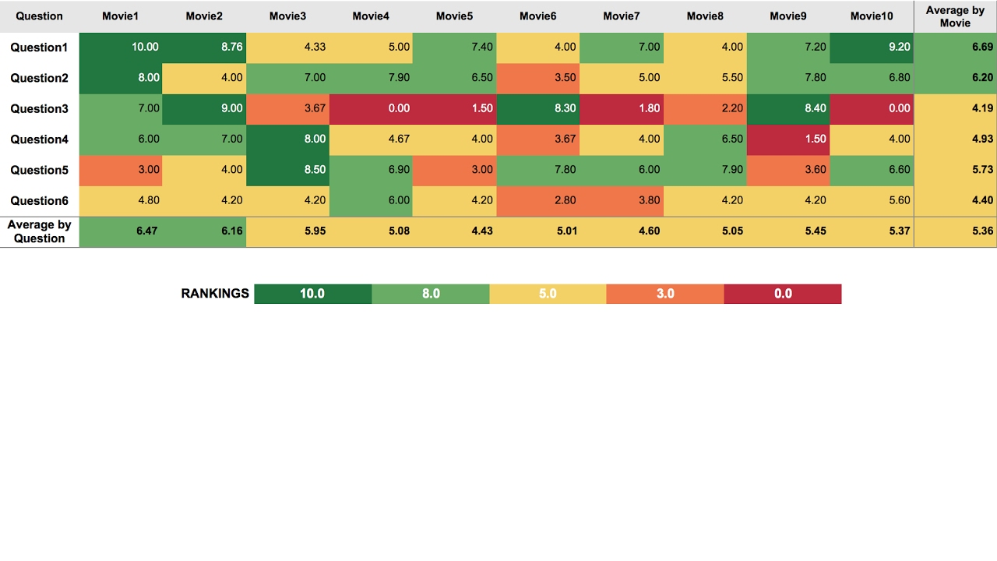
Geospatial displays
The Heat Map : examples

Slide 36
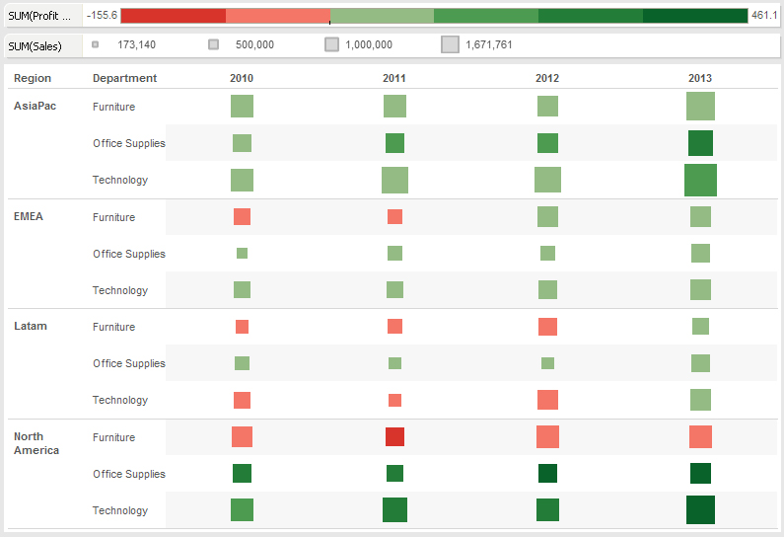
Geospatial displays
The Heat Map : examples

Slide 37
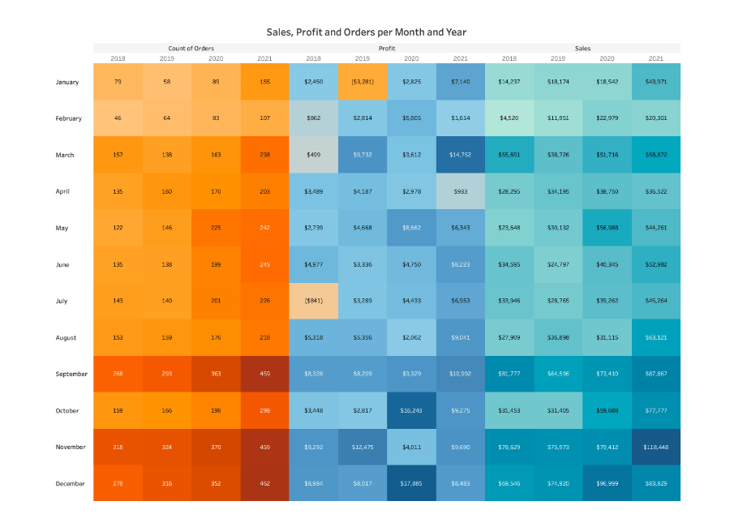
Geospatial displays
The Heat Map : examples

Slide 38
What is heat map analysis?
The process of reviewing and analyzing heat map data to gather insights about user interaction on the page.
Can lead to improved site designs with lower bounce rates, fewer drop-offs, more pageviews, and better conversion rates.
Results can be even more effective by running usability tests (like A/B testing:a method of comparing two versions of a web page or app against each other to determine which one performs better.).

Slide 39
Heat map analysis
Carried out by asking:
Are visitors seeing important content?
To understand if people are actually seeing important content elements or sections on your page, take a look at a scroll map—i.e., the heat map that shows you how far down the page people scroll.
Start by reviewing the position of the average fold, which is the portion of the page people see on their screen without scrolling as soon as they land on your site:

Slide 40
Heat map analysis
Carried out by asking:
Are people clicking on key page elements (links, buttons, and CTAs)?
a click map quickly confirms if users are clicking on them or not:

Slide 41
Heat map analysis
Carried out by asking:
Are people confused by non-clickable elements?
Non-clickable elements that look like they might be clickable can cause confusion and frustration for users who waste their clicks while expecting to be taken elsewhere using mouse tracking heat maps

Slide 42
Heat map analysis
Carried out by asking:
Are people getting distracted?
Identifying where exactly visitors are watching on the web page using eye-tracking heat maps

Slide 43
Heat map analysis
Carried out by asking:
Are people experiencing issues across devices?

Slide 44
Types of website heatmap data visualization
Due to their dynamic and robust nature, website heatmaps enable the graphical representation of data in many forms based on the nature of the data sets.
Businesses use website heatmaps with an online presence to visualize the visitors’ clicks, scrolls, mouse and eye movement, and so on, on their website, in real-time.
Visitor interaction on web pages is visualized in
Heatmaps
Scrollmaps
click maps
mouse-tracking heatmaps
eye-tracking heatmaps.

Slide 45
Heatmap
Heatmap is a graphical way to visualize visitor behavior data in the form of hot and cold spots employing a warm-to-cool color scheme.
The warm colors indicate sections with the most visitor interaction, red being the area of highest interaction, and the cool colors point to the sections with the lowest interaction.

Slide 46
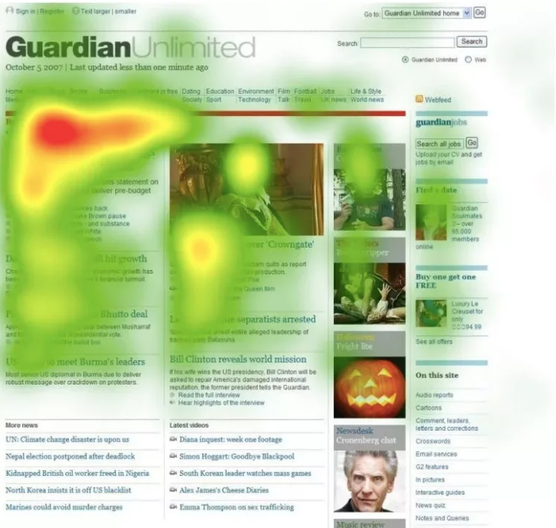
Heatmap

Slide 47
Scroll map
Scroll maps visually present the state of your webpages in the form of a heatmap where all the scroll data (scroll depth, scrolling pattern, etc.) are plotted.
A scroll map indicates the number of visitors scrolled to each section of a webpage, the section after which the percentage of people scrolling drastically falls, the maximum depth till which people scrolled, and more. This data is visualized using colors in a single scroll map, with each color signifying varying intensity of interaction.

Slide 48
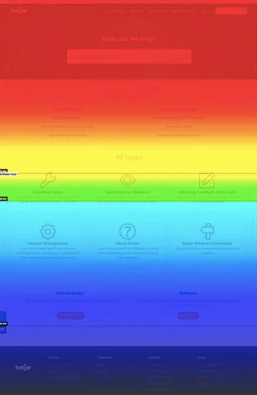
Scroll map

Slide 49
Click map
Website heatmaps also offer click maps that track and visualize click data on the web pages to help to understand visitor behavior at a granular level.
Click maps visually presents clicks on each element of a page like clicks on links, missing/broken links, images, Call to action (CTA), pop-ups, and so on.
With each and every click registered on the webpage, click maps present multiple variables and data points in one single heatmap.

Slide 50

Click map

Slide 51
Mouse tracking heatmap
A color-coded heatmap is generated that visualizes mouse movement data of each visitor as well as data where the individual reports are combined to trace patterns in the mouse movement of the visitors.
At the most general level, mouse tracking heatmaps visualize where visitors’ cursor hovers the most, which section/s of a webpage the cursor keeps coming back to, and more such mouse movement data.

Slide 52
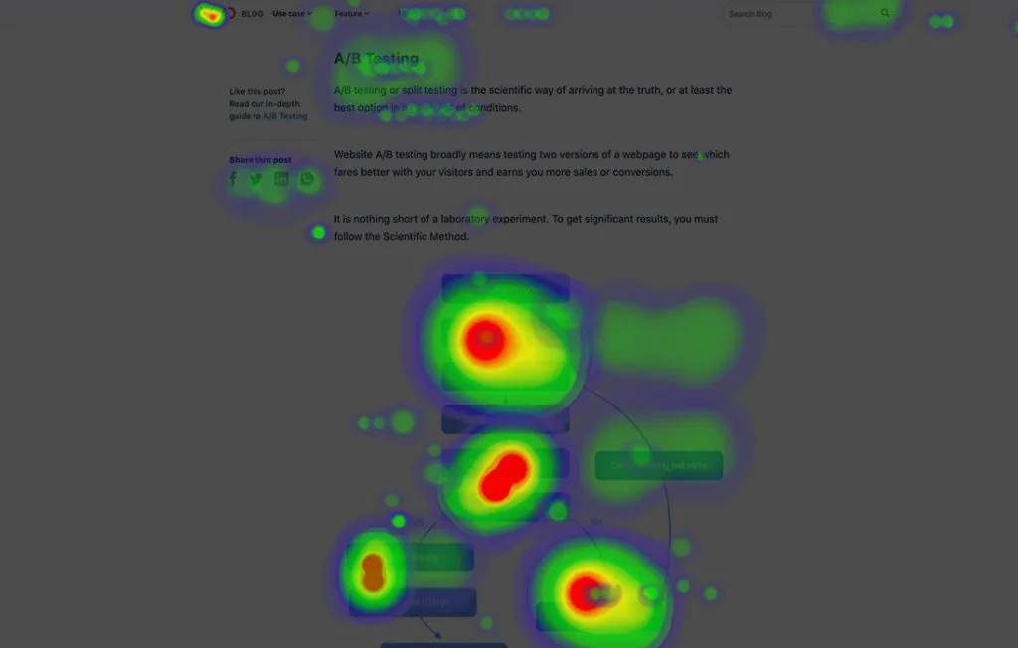
Mouse tracking heatmap

Slide 53
Eye-tracking heatmap
Like mouse tracking heatmap, eye-tracking heatmap also visualizes viewing patterns, but instead of cursor data, data on visitors’ gaze is visualized. Eye-tracking heatmap tracks visitors’ eye movement and visualizes gaze data.
These data include fixation length based on the number of times an image is looked at, which elements attract the visitor’s gaze the most, which irrelevant elements are distracting the visitors’ eye away from the main CTA, and so on.

Slide 54

Eye-tracking heatmap

Slide 55
The benefits of using heat maps on website
Heatmaps help to understand how people interact with website pages, to find answers to business-critical questions such as ‘why are users not converting?’ or ‘how to get more visitors to take action?’
Heat maps can be used to determine if the visitors are:
Reaching important content or failing to see it
Finding and using a page’s main links, buttons, opt-ins, and CTAs
Getting distracted by non-clickable elements
Experiencing issues across devices
help
to be informed
to take data-based decisions for A/B testing
in updating, or (re)designing website.
to show team members and stakeholders what’s happening and get their buy-in more easily when changes are needed

Slide 56
Geospatial displays
Maps
Used to analyze or present data geographically,
Used to display geographic data or as a way to communicate answers to spatial questions such as country, state or any other geographical locations
Before beginning to build a map, be sure to take a careful look at data, analysis, and story
Ensure “appropriate data representation” and “attractive data representation”
Maps can be particularly tricky in their tendency to mislead or inadvertently cause people to misinterpret the data, or to dictate a not-quite-true story.

Slide 57
Geospatial displays
Connecting to Geographic Data
Geographic data is information mapped around a sphere.
Geographic data highlights the latitude and longitude relationships to a specific object or location
Spatial data is any type of data that directly or indirectly references a specific geographical area or location.
Sometimes called geospatial data or geographic information, spatial data can also numerically represent a physical object in a geographic coordinate system. However, spatial data is much more than a spatial component of a map.
A geographic information system (GIS) is a computer system for capturing, storing, checking, and displaying data related to positions on Earth's surface.
By relating seemingly unrelated data, GIS can help individuals and organizations better understand spatial patterns and relationships

Slide 58
Geospatial displays
Assigning Geographic Roles
All geographic fields should have a data type of string, a data role of dimension, and be assigned the appropriate geographic roles.
The exception is latitude/longitude, which should have a data type of number (decimal), a data role of measure, and be assigned the Latitude and Longitude geographic roles.
Geographic fields could be State and County string type data could be adjusted to State field to the Geographic Role of State and the County field to the Geographic Role of County
Tableau will also assign a latitude and longitude to each location

Slide 59
Geospatial displays
Creating Geographic Hierarchies
Hierarchy can be created such as
Country- State- District- City
Region- state - county
This will help in understanding the data in better manner

Slide 60
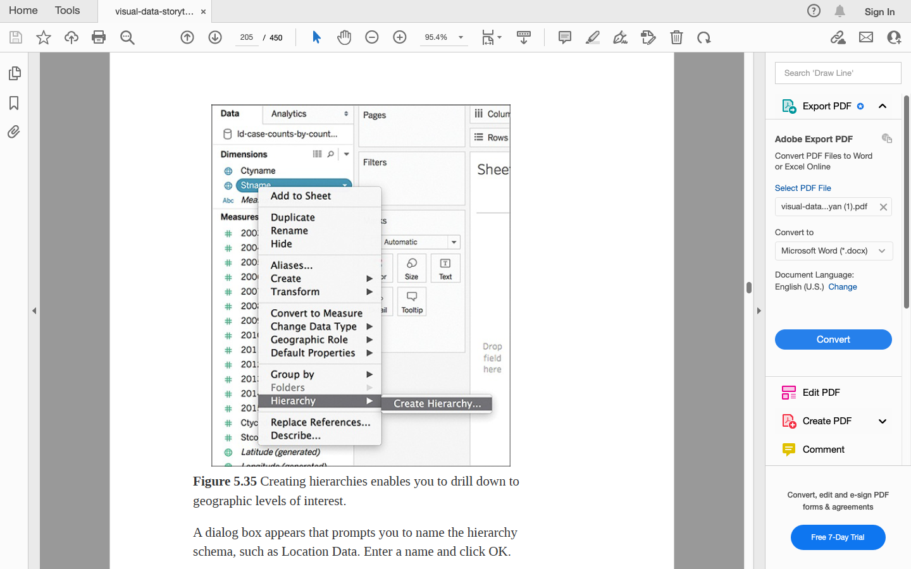
Geographic Hierarchy

Slide 61
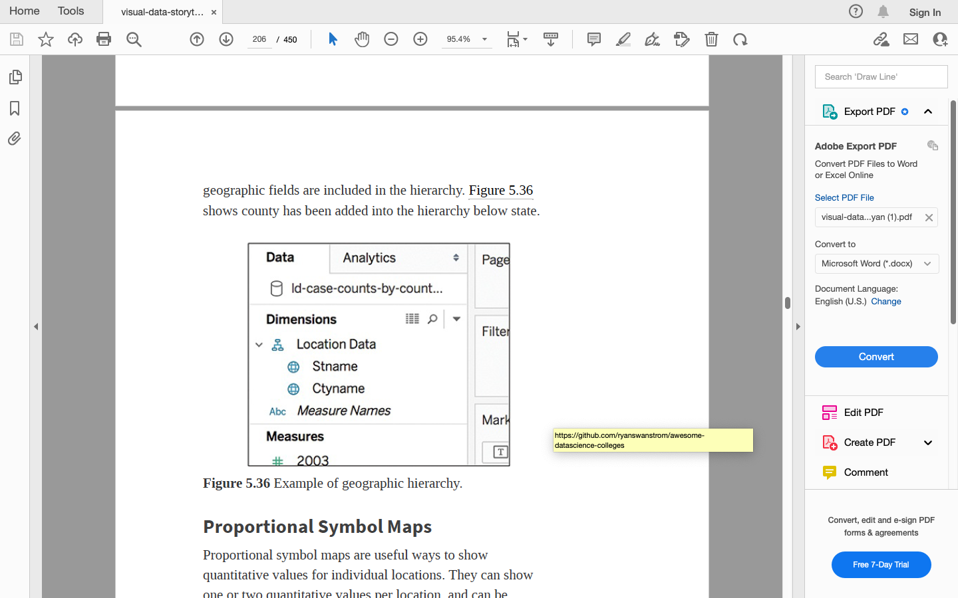
Geographic Hierarchy

Slide 62
Geospatial displays: Proportional Symbol Maps
Merits:
Used to show quantitative values for individual locations
Useful for illustrating differences between many places
Data associated with a specific location
Visually appealing
Can be encoded with visual cues like size and color
Can show one or two quantitative values per location
Easy to read as each symbol is proportional to it's value
Limitations:
Difficult to calculate actual value (if not shown)
Time-consuming to construct
Size may obscure location or mean less accurate positioning on maps

Slide 63
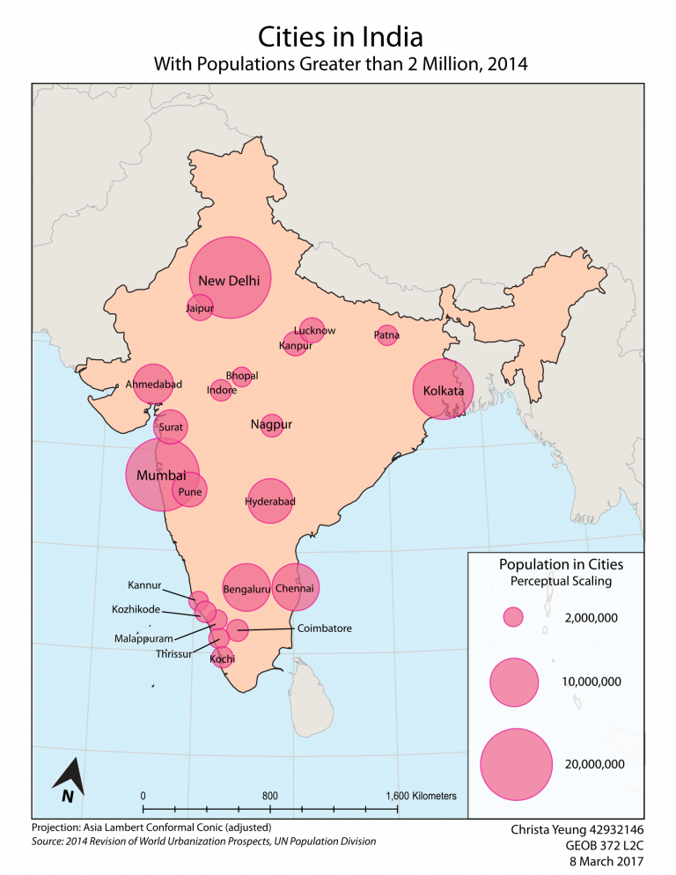
Proportional Symbol maps

Slide 64
Geospatial displays: Choropleth Maps
A great tool for showing ratio or aggregated data.
Use shading and coloring within geographic areas to encode value to a quantity in those areas.
A dataset should include both quantitative and qualitative values, along with location information recognizable by Tableau

Slide 65
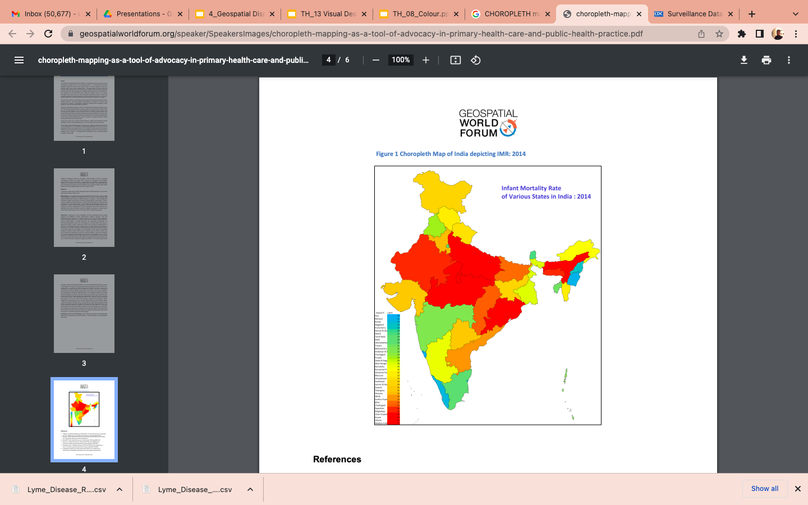
Choropleth maps

Slide 66
Practice
Proportional symbol maps
https://help.tableau.com/current/pro/desktop/en-us/maps_howto_symbol.htm
Choropleth maps
https://help.tableau.com/current/pro/desktop/en-us/maps_howto_choropleth.htm

